Slide 1


What to Expect when Delivering
“A Day in the life of an Amazon delivery Driver”

Slide 2
Daily Cadence –Work Expectation
Arrive at offsite at scheduled time depending on wave. Vans need to be loaded in 20 minutes so it is very important that drivers arrive on time both at the offsite and to the delivery station for load out
Route sizes will vary. For the first two weeks you will be assigned smaller routes “Nursery” After this two week period route size can vary from 150-200 stops and 200-300 packages. Routes can last 10 hours with potential for 11 with the return process
Drivers work 4 days a week with potential overtime
Delivering packages is physically demanding. Expect to get a lot of steps in and packages that weigh 50+ lbs
Our drivers follow strict safety standards on and off the road. Unsafe driving practices can lead to termination. We use technology on vans and devices to monitor driving behavior
You'll interact with Amazon customers and the public in a professional and positive manner- This is not always easy customers are not always friendly and drivers need to maintain composure at all times
You'll use handheld technology to manage the delivery process- Comfortability with the technology is a plus

Slide 3

Work Expectation cont.
Drivers are expected to deliver all packages assigned barring any issues such as unable to locate, missing, no safe locations. Exceptions will be covered later in this document. Excessive return of deliverable packages can lead to corrective action. Drivers are expected to call customers or support to assist with any problem packages
There can be stairs
Outside in element-Rain,snow,etc
Driving in dark and rural areas
Pictures must be taken of delivered packages-If any go missing this protects you as proof of delivery
All packages must be marked before returning to station-Upon returning to station each driver must debrief with the return to station team on any undelivered packages

Slide 4
Start of Day Routine
1. Open the Mentor App
Log in using the email you signed up with and password you created
If you do not remember these you need to get with your manager or reset password yourself
Complete Pre-trip DVCR-Next Page
You MUST log into Mentor every day before you begin your route and leave mentor open all day while you deliver. When you first log in you will be asked to inspect your van. At the end of your day you will be asked to do another inspection for new damage. It is visible to your DSP and to Amazon if you logged into Mentor, and if you did your Pre and Post Trip DVCRs. Failure to do so can lead to disciplinary action.

Slide 5

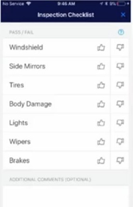
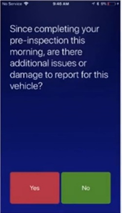
DVCR Completion
Pre-Trip DVCR Cheat Sheet
1. Select “Begin Route”
2. Scan the QR code number for your van located in driver side door
3. You will be directed to the Inspection Checklist that will ask you to inspect key areas of your van (any damage marked will require a photo).
4. Select “File Report” to submit the inspection.
Post- Trip DVCR Cheat Sheet
1. Select End Route
2. Any new damage? Walk around your vehicle and look for new damage. If there is none select no. If there is select yes and enter it into the Inspection Checklist then File Report to end your route.

Slide 6
Safely Driving to the Warehouse
1. Honk your horn on your way up the ramp
2. The speed limit throughout the entire Amazon campus is 5 mph, that includes inside the warehouse and in the parking lot
3. Headlights and Hazard lights on
4. Windows down. No music. No headphones.
5. Once parked inside turn your engine off. NO IDLING IN THE WAREHOUSE
6. Once loaded and getting ready to leave, honk before leaving your parking spot
7. Honk when exiting the building

Slide 7

Amazon Flex App
Open the Amazon Flex App
- Use the email you used to set up an account on Concour (This one could not be associated with any other Amazon account in any way)
- Enter password you created for this account
- Enter mileage of your van
-Choose option “scan packages” DO NOT SWIPE TO FINISH YET

Slide 8
Locating your route
Once you’ve selected “Scan Packages” the next screen will tell you were your packages are located
There are four blue taped off rows that will be full of picked routes on U-boats. They are on a grid that uses Letters to determine the row, and numbers to determine where the route is in that row. (i.e. STG.A01, STG.D18)
Insert staging map

Slide 9
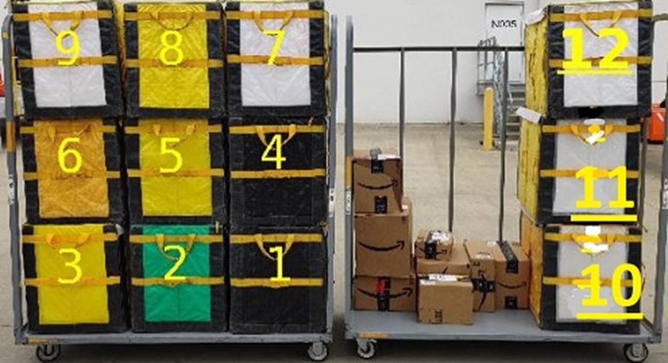
Bag Order
The bags will be loaded on the carts in the same way every time

Slide 10
How to load the van

Slide 11
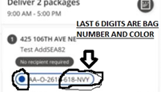
How do I find the bag a package is in if they’re out of order?
The bag that a package is in will be identified in the Rabbit on nearly every screen from your delivery summary to the scan package screen. For example, in the picture on the right, you will see the packages you are looking for are located in a blue bag that is numbered 618.

Slide 12
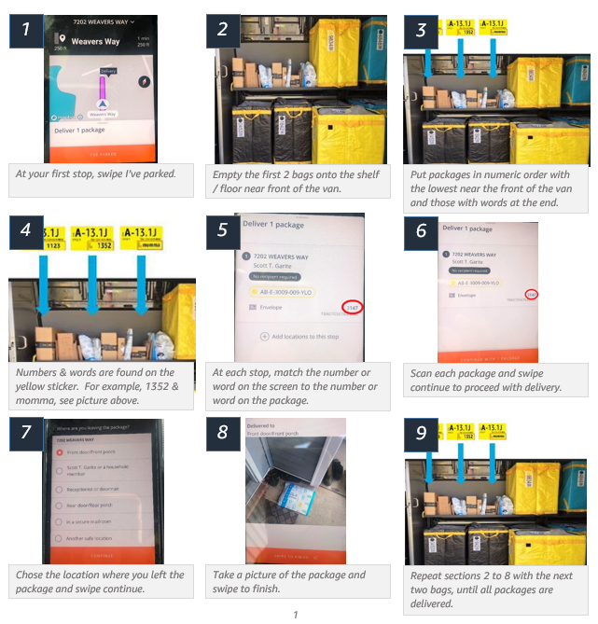
Arranging Packages- Once on the Road

Slide 13
On the road FAQ’s

Slide 14
How should I mark a package that I deliver to a customer?
When you deliver a package you will be marking it in the Rabbit app to let us, and the customer know where you left it.
Customer or Household Member – Should be used anytime you hand the package directly to the customer or a member of their household
Receptionist or Doorman – Used anytime we leave the package with a third party authorized to accept packages for the customer
Secure Mailroom – Used when a package is left in a secure mailroom for the customer to pick up
Front Door/Front Porch – Used when a package is left in a secure location on the customers front porch
Back Door/Back Porch – Used when a package is left in a secure location on the customers back porch
Another Secure Location – Used when a package is left in a secure location that does not fall into any other category (i.e. Garage, Side Door, Bin for delivered Packages)

Slide 15
What about packages I am unable to deliver?
• Access problem – When you are unable to physically approach the customers home (i.e. Closed street, dog in the yard, steep ice covered driveway)
• Can’t find address – When you cannot find the customer’s home
• Security access code needed – When you can’t deliver to a customer because of security reasons (i.e. Code needed to get into apartment building, gated community and guard won’t let you in)
• Business closed – When the business you are delivering to is closed for the day (Please enter the correct business hours into the app)
• Nowhere safe to leave packages – When there is no secure place to leave a package
Before marking a package Unable to deliver, please exhaust all resources to get this package to the customer. Call the customer, Text the customer, then call again. Also reach out to your DSP, they may have suggestions to help you complete the delivery.

Slide 16

What if a package is missing?

Slide 17
What if I find a package not on my route?
All packages MUST be attempted. Even packages that are not technically on your route. If you find a package in one of your bags not included on your route, please “Pick Up” that package and attempt delivery. All packages must be attempted TWICE. If you cannot complete a delivery you will need to go back to that location a second time in your route to attempt the delivery again.

Slide 18

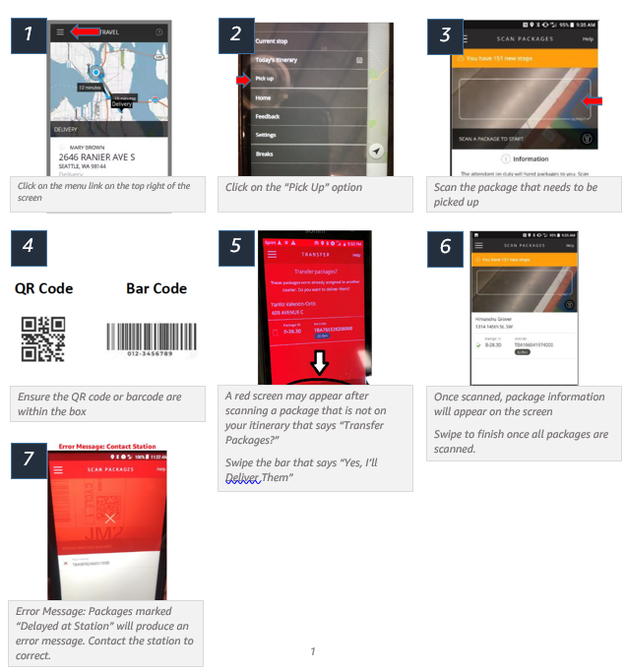
How do I “pick up” a package in my Rabbit?

Slide 19
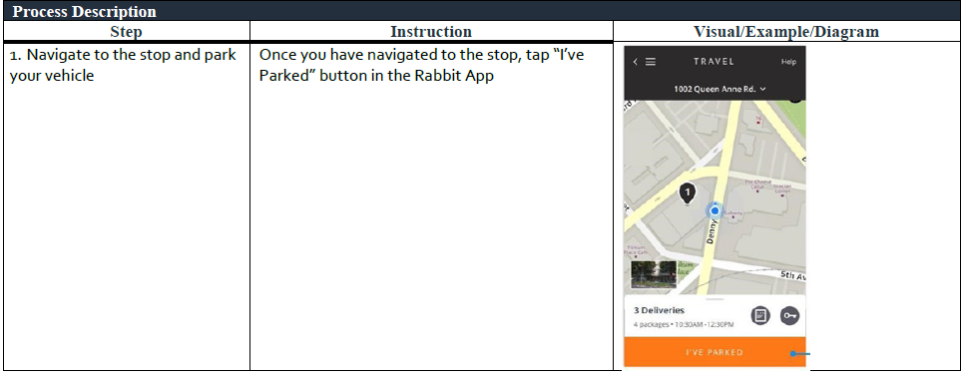
How do I deliver to group stops?

Slide 20
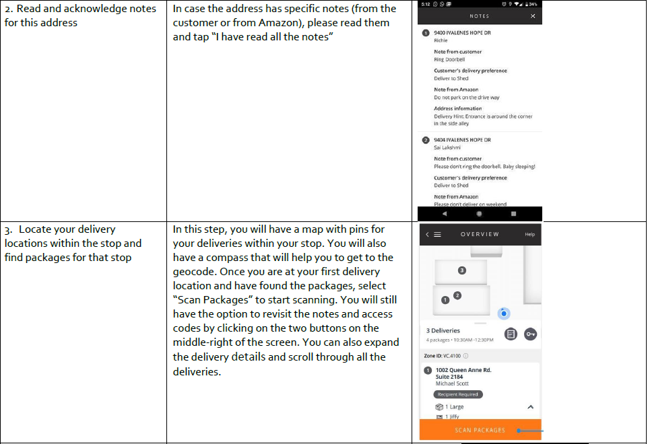
Group stops (cont)

Slide 21
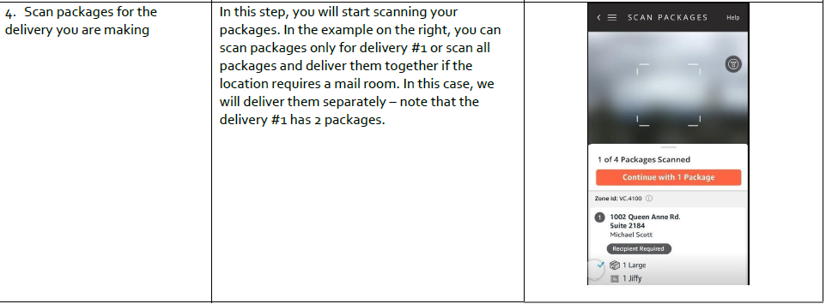
Group stops (cont)

Slide 22
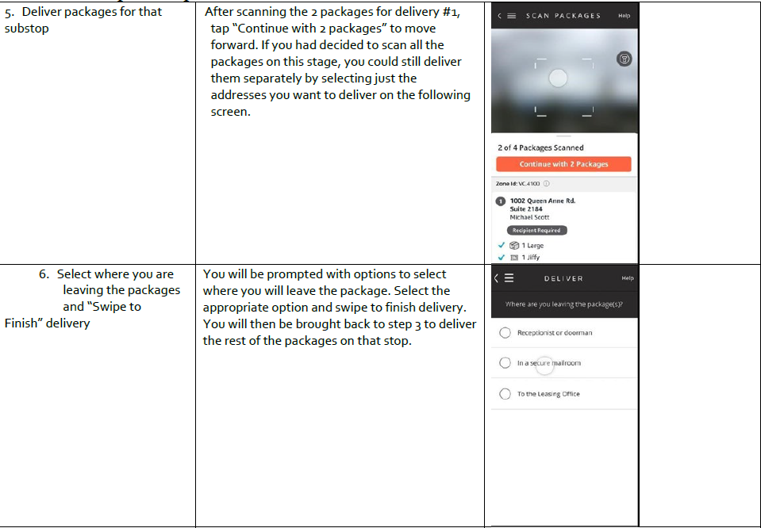
Group Stops(cont)

Slide 23
How do I keep my FICO score Up?
Mentor measures the following things while you are driving on your route:
Acceleration: Hard acceleration <9mph/second (0-30mph count to 3)
Braking: Hard braking <9mph/second (30-0mph count to 3)
Cornering: Hard cornering (Do not take turns >20mph)
Distraction: Any interaction with the device while the vehicle is in motion. (DO NOT log in on your personal phone!)
Speeding: >10 mph above posted speed limit for more than 40 secs
The best thing you can do to keep your Mentor score high is NEVER touch your device while driving and go the speed limit while making your deliveries. If you maintain a reasonable speed it greatly reduces the chances of harsh cornering, hard braking and, quick accelerations

Slide 24
FICO 5 for Safe Driving
1. ACCELERATING: Avoid jack rabbit starts and remain calm. Drivers who are aggressive drivers often accelerate and don’t put their safety or other’s safety above all else.
2. BREAKING: Keep 1 van length between you and the car in front of you AT ALL TIMES.
3. CORNERING: Remember to brake before turning a corner. Remember the three S’s: Slowly, Smoothly & Steady.
4. DISTRACTIONS: LOG INTO EMENTOR ON YOUR PERSONAL PHONE, PUT THE PHONE IN THE MOUNT, DO NOT TOUCH AGAIN UNTIL AFTER THE ROUTE. Every time you touch the phone and the vehicle is in motion (to answer a call, to decline a call, to send a text), it will hit your FICO. ONLY TOUCH YOUR PHONE WHEN THE VAN IS OFF.
5. SPEEDING: If posted speed limit is < 40 mph, a driver must exceed the speed limit by 20% or more for at least 60 seconds.
If posted speed limit is > or = to 40mph, a driver must exceed the speed limit by 10 mph or more for at least 60 seconds.
6 . Why did I get a distraction event when I used my Bluetooth device to make a hands-free call? There is no difference in brain distraction between hand-held and hands-free phone use—they are equally distracting and therefore are equally counted as negative events in Mentor. Soon you will receive the Distracted Driving series of coaching modules with our own brain science advisor, Dr. Paul Atchley, in your playlist, which will convince you why you need leave your phone alone while behind the wheel! If you have already seen them, we encourage you to go watch them again.

